Slide 1


Human - Computer
Interaction
Present by Chi Nguyen

Slide 2
CONTENTS
The human
The computer
The interaction
Paradigms

Slide 3
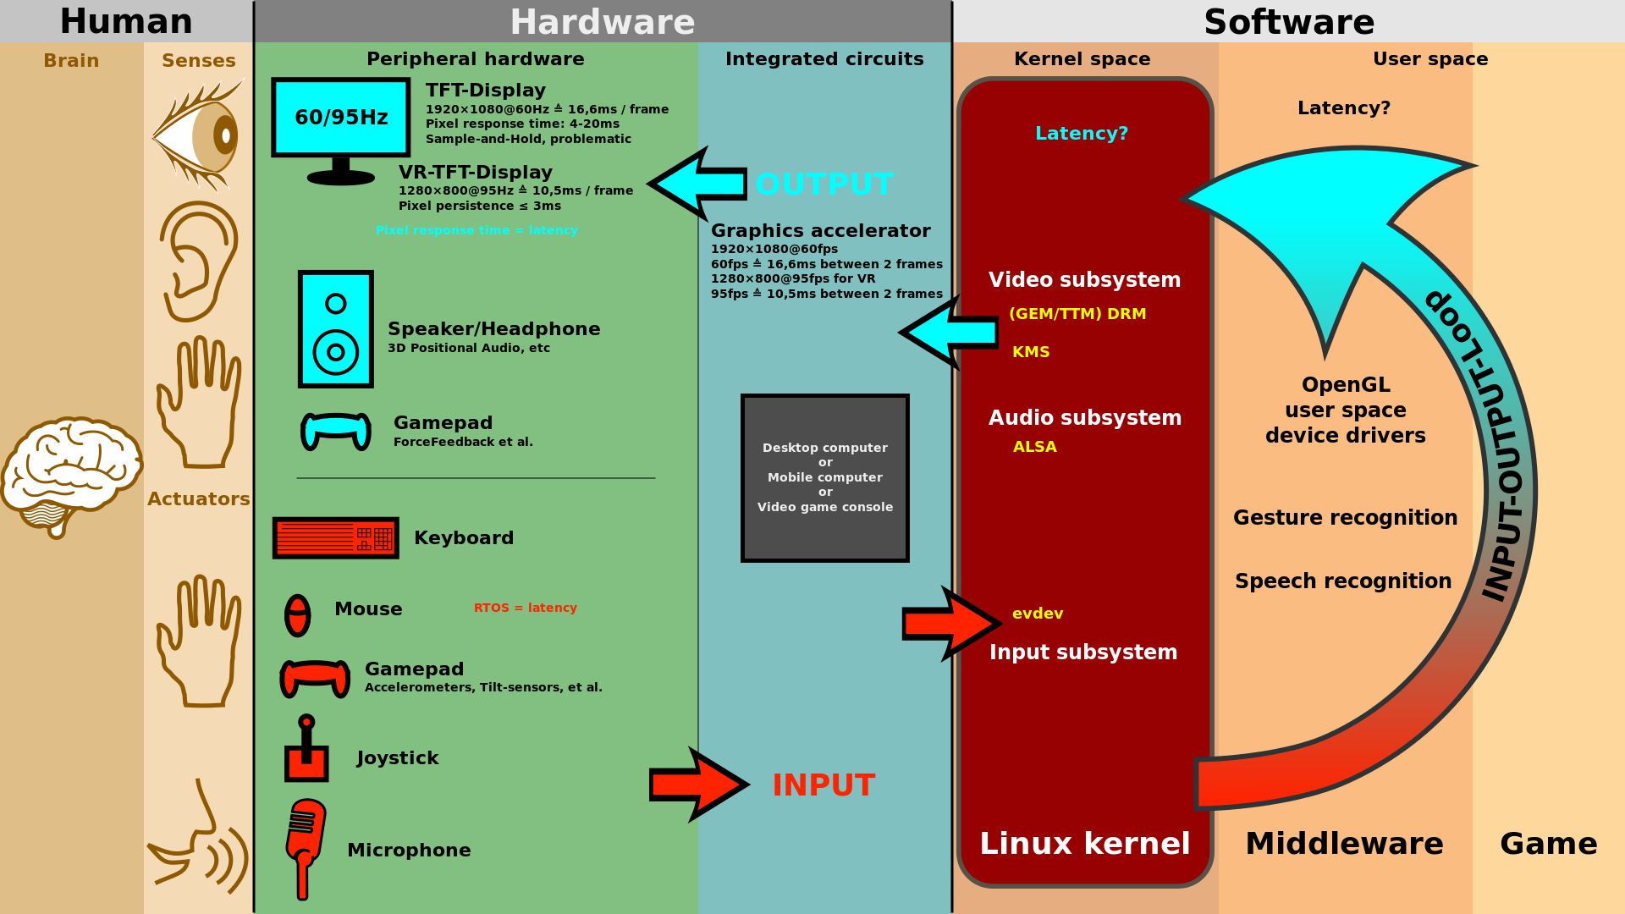

Slide 4











THE HUMAN
VISION
THINKING
HEARING
EMOTION
TOUCH
INDIVIDUAL DIFFERENCES
MOVEMENT
PSYCHOLOGY
MEMORY
INFORMATION

Slide 5
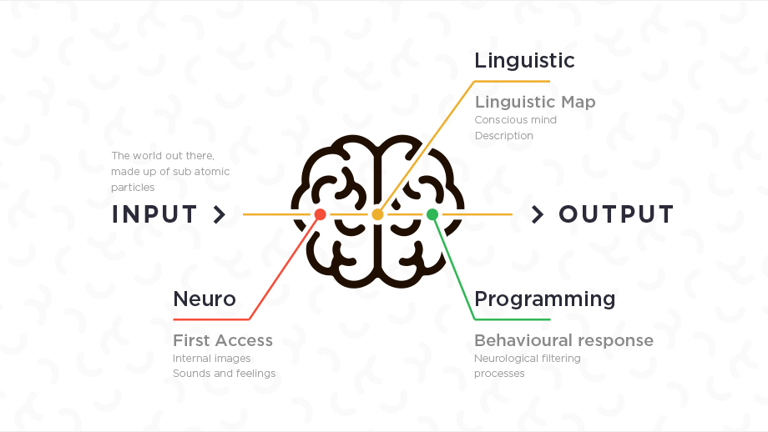
What’s NLP?
Notes:
Vậy NLP là gì? Có ai biết về đề tài này chưa ạ? (để mọi người tương tác trả lời. Nếu mọi người im lìm mình tiếp tục thuyết trình)
Vậy em xin giới thiệu với mọi người về NLP là gì nhé!
NLP là viết tắt của Neuro Linguistic Programming
thế giới ngoài kia
được tạo thành từ các hạt hạ nguyên tử
Thần kinh
truy cập đầu tiên
hình ảnh nội bộ
âm thanh và cảm xúc
Ngôn ngữ học
Bản đồ ngôn ngữ
tâm trí có ý thức
sự miêu tả
Lập trình
Phản ứng hành vi
quá trình lọc thần kinh

Slide 6

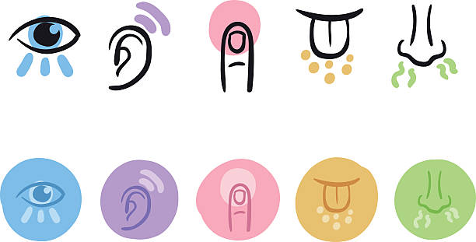


INTERNAL REPRESENTATION
Collage vs Library
Generalize
Distort
Delete
REALITY
STATE
Meaning
PHYSICOLOGY
Feeling
ACTION
Behavior / Response

Slide 7

THE HUMAN
-
INFORMATION
INFORMATION INPUT / OUTPUT
  Visual
  Auditory
  Haptic
  Movement
INFORMATION STORED IN MEMORY
  Sensory
  Short-term
  Long-term
INFORMATION PROCESSED
AND APPLIED
  Reasoning
  Problem solving
  Skill
  Error

Slide 8
THE HUMAN
-
INFORMATION
EMOTION INFLUENCES
HUMAN CAPABILITIES
EACH PERSON IS DIFFERENT

Slide 9
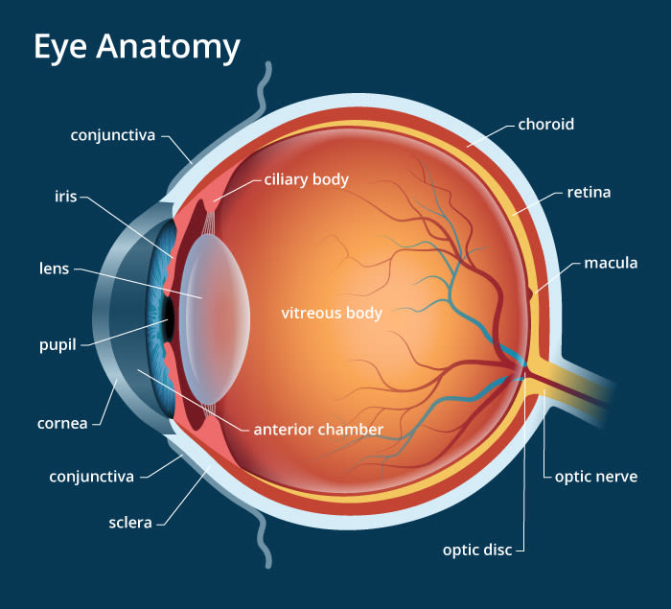
THE HUMAN
-
VISION
PHYSICAL RECEPTION - THE EYE
What you can see
  Pupil - the lens covering hole into the eye
  Iris - muscles to change lens shape
Notes:
PHYSICAL RECEPTION - THE EYE
Mechanism for receiving light and transforming it into electrical energy
Light reflects from objects
Images are focused upside-down on retina
Retina contains rods for low light vision and comes for colour vision
Ganglion cells (brain!) detact pattern and movement
PROCESSING AND INTERPRETATION
Interpreting the signal
Size and depth
Visual angle indicates how much of view object occupies
(relates to size and distance from eye)
Visual acuity is ability to perceive detail (limited)
Familiar object perceived as constant size
(in spite of changes in visual angle when far away)
Cues like overlapping help perception of size and depth
Brightness
Subjective reaction to levels of light
Affected by just noticeable difference
Visual acuity increases with luminance as does flicker
Colour
Made up of hue, intensity, saturation
Cones sensitive to colour wave lengths
Blue acuity is lowest
8% males and 1% females colour blind
The visual system compensates for
Movement
Changes in luminances
Context is used to resolve ambiguity
Optical illusions sometimes occur due to over compensation
Optical illusions
Reading

Slide 10
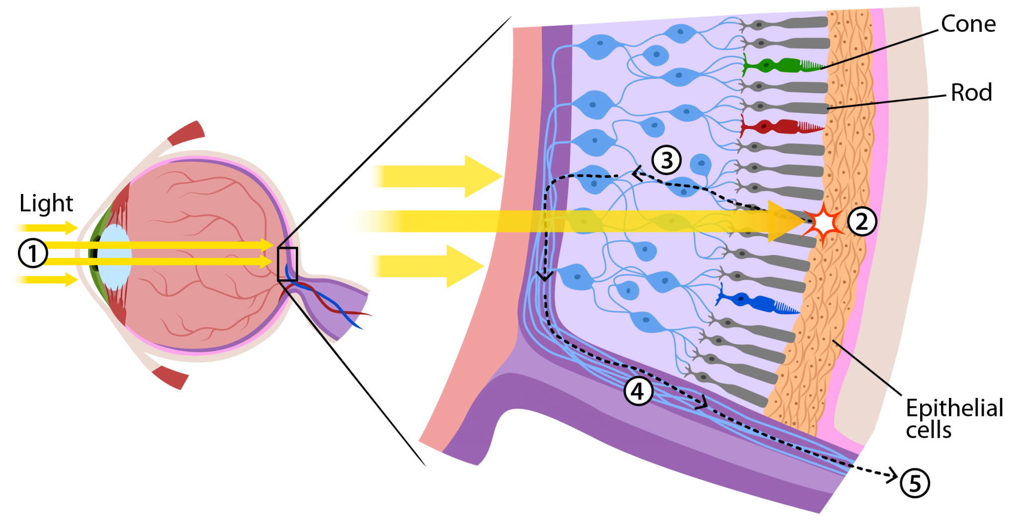
THE HUMAN
-
VISION
PHYSICAL RECEPTION - THE EYE
What you can see
  Pupil - the lens covering hole into the eye
  Iris - muscles to change lens shape
Behind the scenes
  Upside down image (lens inverts)
  Cells to detect light (rods and cones)
Notes:
PHYSICAL RECEPTION - THE EYE
Mechanism for receiving light and transforming it into electrical energy
Light reflects from objects
Images are focused upside-down on retina
Retina contains rods for low light vision and comes for colour vision
Ganglion cells (brain!) detact pattern and movement
PROCESSING AND INTERPRETATION
Interpreting the signal
Size and depth
Visual angle indicates how much of view object occupies
(relates to size and distance from eye)
Visual acuity is ability to perceive detail (limited)
Familiar object perceived as constant size
(in spite of changes in visual angle when far away)
Cues like overlapping help perception of size and depth
Brightness
Subjective reaction to levels of light
Affected by just noticeable difference
Visual acuity increases with luminance as does flicker
Colour
Made up of hue, intensity, saturation
Cones sensitive to colour wave lengths
Blue acuity is lowest
8% males and 1% females colour blind
The visual system compensates for
Movement
Changes in luminances
Context is used to resolve ambiguity
Optical illusions sometimes occur due to over compensation
Optical illusions
Reading

Slide 11
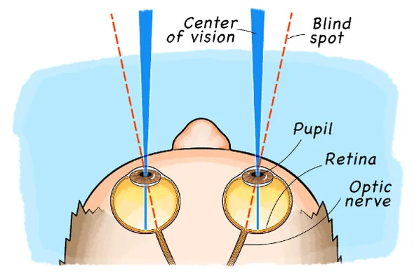
THE HUMAN
-
VISION
PHYSICAL RECEPTION - THE EYE
What you can see
  Pupil - the lens covering hole into the eye
  Iris - muscles to change lens shape
Behind the scenes
  Upside down image (lens inverts)
  Cells to detect light (rods and cones)
  Optic nerve - blind spot... filling in
Notes:
PHYSICAL RECEPTION - THE EYE
Mechanism for receiving light and transforming it into electrical energy
Light reflects from objects
Images are focused upside-down on retina
Retina contains rods for low light vision and comes for colour vision
Ganglion cells (brain!) detact pattern and movement
PROCESSING AND INTERPRETATION
Interpreting the signal
Size and depth
Visual angle indicates how much of view object occupies
(relates to size and distance from eye)
Visual acuity is ability to perceive detail (limited)
Familiar object perceived as constant size
(in spite of changes in visual angle when far away)
Cues like overlapping help perception of size and depth
Brightness
Subjective reaction to levels of light
Affected by just noticeable difference
Visual acuity increases with luminance as does flicker
Colour
Made up of hue, intensity, saturation
Cones sensitive to colour wave lengths
Blue acuity is lowest
8% males and 1% females colour blind
The visual system compensates for
Movement
Changes in luminances
Context is used to resolve ambiguity
Optical illusions sometimes occur due to over compensation
Optical illusions
Reading

Slide 12
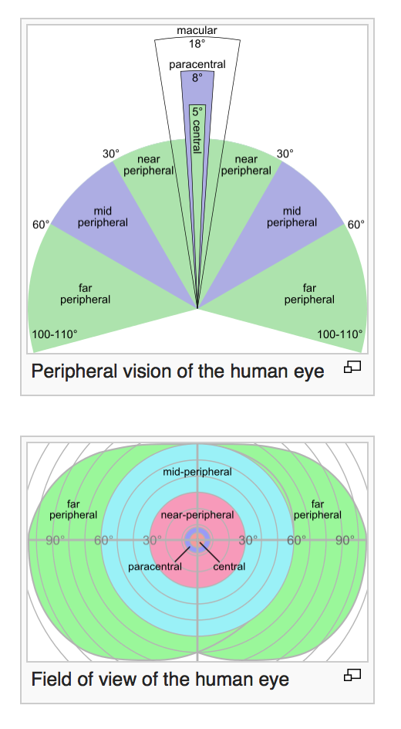
THE HUMAN
-
VISION
PHYSICAL RECEPTION - THE EYE
Focus and attention
  Fovea
    Centre of vision
    Maily cones
    Pretty small -> need saccades
  Peripheral vision
    Mainly rods
    Detect movement -> catch attention
=> if you have rapid movement at the edge of your vision, it will grab your attention
Notes:
PHYSICAL RECEPTION - THE EYE
Mechanism for receiving light and transforming it into electrical energy
Light reflects from objects
Images are focused upside-down on retina
Retina contains rods for low light vision and comes for colour vision
Ganglion cells (brain!) detact pattern and movement
PROCESSING AND INTERPRETATION
Interpreting the signal
Size and depth
Visual angle indicates how much of view object occupies
(relates to size and distance from eye)
Visual acuity is ability to perceive detail (limited)
Familiar object perceived as constant size
(in spite of changes in visual angle when far away)
Cues like overlapping help perception of size and depth
Brightness
Subjective reaction to levels of light
Affected by just noticeable difference
Visual acuity increases with luminance as does flicker
Colour
Made up of hue, intensity, saturation
Cones sensitive to colour wave lengths
Blue acuity is lowest
8% males and 1% females colour blind
The visual system compensates for
Movement
Changes in luminances
Context is used to resolve ambiguity
Optical illusions sometimes occur due to over compensation
Optical illusions
Reading

Slide 13
THE HUMAN
-
VISION
PHYSICAL RECEPTION - THE EYE
PROCESSING AND INTERPRETATION
  Interpreting the signal
  Reading
Notes:
PHYSICAL RECEPTION - THE EYE
Mechanism for receiving light and transforming it into electrical energy
Light reflects from objects
Images are focused upside-down on retina
Retina contains rods for low light vision and comes for colour vision
Ganglion cells (brain!) detact pattern and movement
PROCESSING AND INTERPRETATION
Interpreting the signal
Size and depth
Visual angle indicates how much of view object occupies
(relates to size and distance from eye)
Visual acuity is ability to perceive detail (limited)
Familiar object perceived as constant size
(in spite of changes in visual angle when far away)
Cues like overlapping help perception of size and depth
Brightness
Subjective reaction to levels of light
Affected by just noticeable difference
Visual acuity increases with luminance as does flicker
Colour
Made up of hue, intensity, saturation
Cones sensitive to colour wave lengths
Blue acuity is lowest
8% males and 1% females colour blind
The visual system compensates for
Movement
Changes in luminances
Context is used to resolve ambiguity
Optical illusions sometimes occur due to over compensation
Optical illusions
Reading

Slide 14
THE HUMAN
-
VISION
PHYSICAL RECEPTION - THE EYE
PROCESSING AND INTERPRETATION
  Interpreting the signal
    Size and depth
    Brightness
    Colour
Notes:
PHYSICAL RECEPTION - THE EYE
Mechanism for receiving light and transforming it into electrical energy
Light reflects from objects
Images are focused upside-down on retina
Retina contains rods for low light vision and comes for colour vision
Ganglion cells (brain!) detact pattern and movement
PROCESSING AND INTERPRETATION
Interpreting the signal
Size and depth
Visual angle indicates how much of view object occupies
(relates to size and distance from eye)
Visual acuity is ability to perceive detail (limited)
Familiar object perceived as constant size
(in spite of changes in visual angle when far away)
Cues like overlapping help perception of size and depth
Brightness
Subjective reaction to levels of light
Affected by just noticeable difference
Visual acuity increases with luminance as does flicker
Colour
Made up of hue, intensity, saturation
Cones sensitive to colour wave lengths
Blue acuity is lowest
8% males and 1% females colour blind
The visual system compensates for
Movement
Changes in luminances
Context is used to resolve ambiguity
Optical illusions sometimes occur due to over compensation
Reading

Slide 15

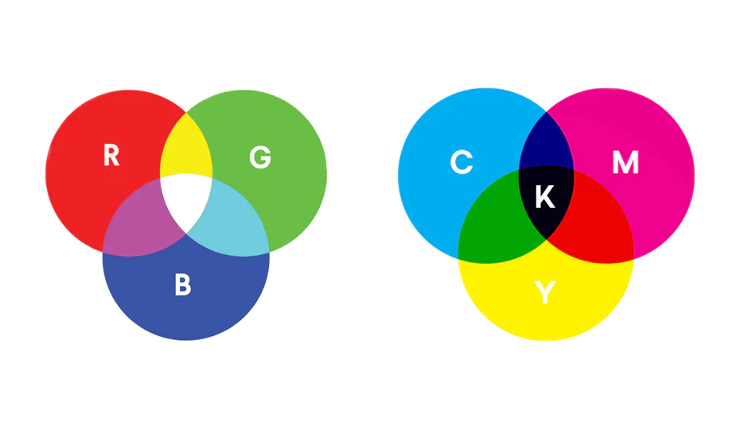
THE HUMAN
-
VISION
COLOUR
  Light
  RGB vs CMYK
Notes:
PHYSICAL RECEPTION - THE EYE
Mechanism for receiving light and transforming it into electrical energy
Light reflects from objects
Images are focused upside-down on retina
Retina contains rods for low light vision and comes for colour vision
Ganglion cells (brain!) detact pattern and movement
PROCESSING AND INTERPRETATION
Interpreting the signal
Size and depth
Visual angle indicates how much of view object occupies
(relates to size and distance from eye)
Visual acuity is ability to perceive detail (limited)
Familiar object perceived as constant size
(in spite of changes in visual angle when far away)
Cues like overlapping help perception of size and depth
Brightness
Subjective reaction to levels of light
Affected by just noticeable difference
Visual acuity increases with luminance as does flicker
Colour
Made up of hue, intensity, saturation
Cones sensitive to colour wave lengths
Blue acuity is lowest
8% males and 1% females colour blind
The visual system compensates for
Movement
Changes in luminances
Context is used to resolve ambiguity
Optical illusions sometimes occur due to over compensation
Reading
Several stages:
Visual pattern perceived
Decoded using internal represenation of language
Interpreted using knowledge of syntax, semantics, pragmatics
Reading involves saccades and fixations
Perception occurs during fixations
Word shape is important to recognition
Negative contrast improves reading from computer screen

Slide 16
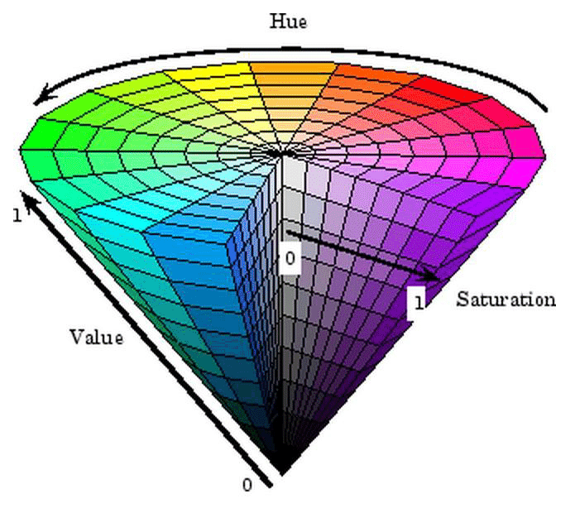
THE HUMAN
-
VISION
COLOUR
  Light
  RGB vs CMYK
  Contract
  3 factors:
    Hue
    Intensity (Value)
    Saturation
  The eye can see millions colours
  Colour blind: 8% male, 1% female
Notes:
PHYSICAL RECEPTION - THE EYE
Mechanism for receiving light and transforming it into electrical energy
Light reflects from objects
Images are focused upside-down on retina
Retina contains rods for low light vision and comes for colour vision
Ganglion cells (brain!) detact pattern and movement
PROCESSING AND INTERPRETATION
Interpreting the signal
Size and depth
Visual angle indicates how much of view object occupies
(relates to size and distance from eye)
Visual acuity is ability to perceive detail (limited)
Familiar object perceived as constant size
(in spite of changes in visual angle when far away)
Cues like overlapping help perception of size and depth
Brightness
Subjective reaction to levels of light
Affected by just noticeable difference
Visual acuity increases with luminance as does flicker
Colour
Made up of hue, intensity, saturation
Cones sensitive to colour wave lengths
Blue acuity is lowest
8% males and 1% females colour blind
The visual system compensates for
Movement
Changes in luminances
Context is used to resolve ambiguity
Optical illusions sometimes occur due to over compensation
Reading
Several stages:
Visual pattern perceived
Decoded using internal represenation of language
Interpreted using knowledge of syntax, semantics, pragmatics
Reading involves saccades and fixations
Perception occurs during fixations
Word shape is important to recognition
Negative contrast improves reading from computer screen

Slide 17
THE HUMAN
-
VISION
PHYSICAL RECEPTION - THE EYE
PROCESSING AND INTERPRETATION
  Interpreting the signal
    Size and depth
    Brightness
    Colour
    The visual system compensates for
    Context is used to resolve ambniguity
    Optical illusions
  Reading
Notes:
PHYSICAL RECEPTION - THE EYE
Mechanism for receiving light and transforming it into electrical energy
Light reflects from objects
Images are focused upside-down on retina
Retina contains rods for low light vision and comes for colour vision
Ganglion cells (brain!) detact pattern and movement
PROCESSING AND INTERPRETATION
Interpreting the signal
Size and depth
Visual angle indicates how much of view object occupies
(relates to size and distance from eye)
Visual acuity is ability to perceive detail (limited)
Familiar object perceived as constant size
(in spite of changes in visual angle when far away)
Cues like overlapping help perception of size and depth
Brightness
Subjective reaction to levels of light
Affected by just noticeable difference
Visual acuity increases with luminance as does flicker
Colour
Made up of hue, intensity, saturation
Cones sensitive to colour wave lengths
Blue acuity is lowest
8% males and 1% females colour blind
The visual system compensates for
Movement
Changes in luminances
Context is used to resolve ambiguity
Optical illusions sometimes occur due to over compensation
Reading

Slide 18
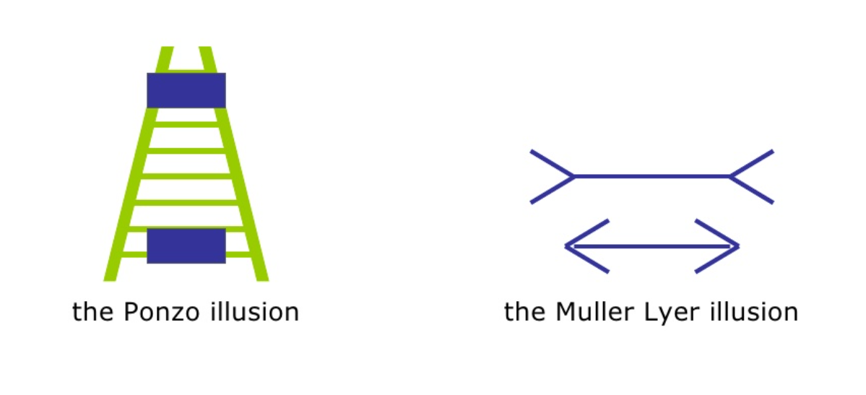
OPTICAL ILLUSIONS
Notes:
The Ponzo illusion is a geometrical-optical illusion that was first demonstrated by the Italian psychologist Mario Ponzo (1882–1960) in 1911. He suggested that the human mind judges an object's size based on its background.
The Müller-Lyer illusion is an optical illusion consisting of three stylized arrows. When viewers are asked to place a mark on the figure at the midpoint, they invariably place it more towards the "tail" end. The illusion was devised by Franz Carl Müller-Lyer (1857–1916), a German sociologist, in 1889.

Slide 19
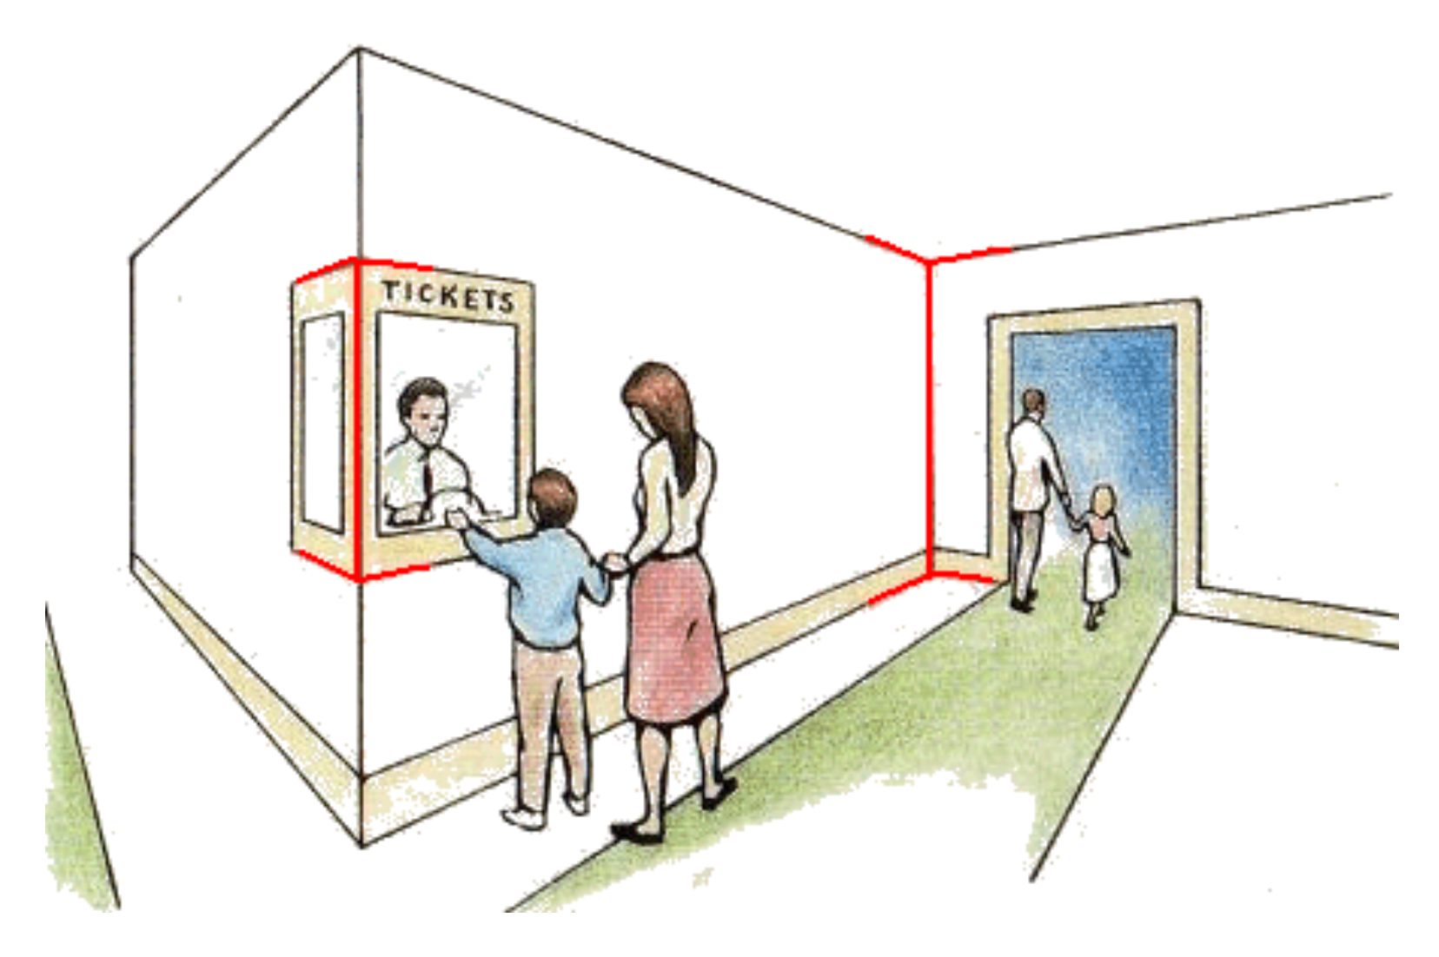
OPTICAL ILLUSIONS
Notes:
The Ponzo illusion is a geometrical-optical illusion that was first demonstrated by the Italian psychologist Mario Ponzo (1882–1960) in 1911. He suggested that the human mind judges an object's size based on its background.
The Müller-Lyer illusion is an optical illusion consisting of three stylized arrows. When viewers are asked to place a mark on the figure at the midpoint, they invariably place it more towards the "tail" end. The illusion was devised by Franz Carl Müller-Lyer (1857–1916), a German sociologist, in 1889.

Slide 20
THE HUMAN
-
VISION
PHYSICAL RECEPTION - THE EYE
PROCESSING AND INTERPRETATION
  Interpreting the signal
  Reading
    Several stages:
      Visual pattern perceived
      Decoded using internal representation of language
      Interpreted using knowledge of syntax, semantics, pragmatics
    Reading involves saccades and fixations
    Perception occurs during fixations
    Word shape is important to recognition
    Negative contrast improves reading from computer screen
Notes:
PHYSICAL RECEPTION - THE EYE
Mechanism for receiving light and transforming it into electrical energy
Light reflects from objects
Images are focused upside-down on retina
Retina contains rods for low light vision and comes for colour vision
Ganglion cells (brain!) detact pattern and movement
PROCESSING AND INTERPRETATION
Interpreting the signal
Size and depth
Visual angle indicates how much of view object occupies
(relates to size and distance from eye)
Visual acuity is ability to perceive detail (limited)
Familiar object perceived as constant size
(in spite of changes in visual angle when far away)
Cues like overlapping help perception of size and depth
Brightness
Subjective reaction to levels of light
Affected by just noticeable difference
Visual acuity increases with luminance as does flicker
Colour
Made up of hue, intensity, saturation
Cones sensitive to colour wave lengths
Blue acuity is lowest
8% males and 1% females colour blind
The visual system compensates for
Movement
Changes in luminances
Context is used to resolve ambiguity
Optical illusions sometimes occur due to over compensation
Reading
Several stages:
Visual pattern perceived
Decoded using internal represenation of language
Interpreted using knowledge of syntax, semantics, pragmatics
Reading involves saccades and fixations
Perception occurs during fixations
Word shape is important to recognition
Negative contrast improves reading from computer screen

Slide 21
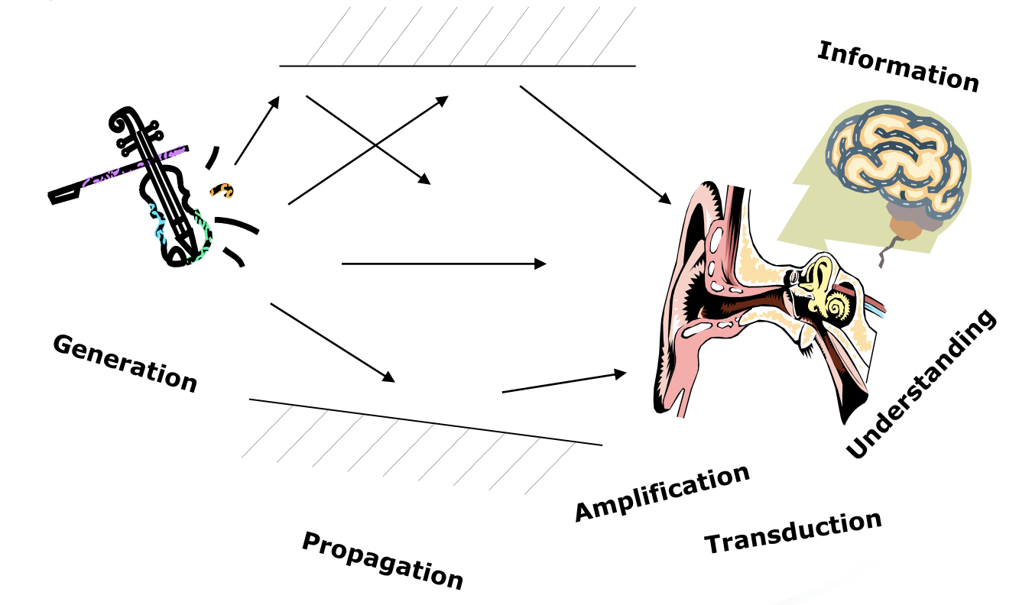
THE HUMAN - HEARING
PROVIDES INFORMATION ABOUT ENVIRONMENT
  Distances, directions, objects...
PHYSICAL APPARATUS
  Outer ear - Middle ear - Inner ear
SOUND
  Pitch: sound frequency
  Loudness: amplitude
  Timbre: type or quality
HUMAN CAN HEAR FREQUENCIES
20Hz - 15kHz
AUDITORY SYSTEM FILTERS SOUNDS
Notes:
PROVIDES INFORMATION ABOUT ENVIRONMENT
Distances, directions, objects...
PHYSICAL APPARATUS
Outer ear: protects inner and amplifies sound
Middle ear: transmits sound waves as vibration to inner ear
Inner ear: chemical transmitters are released and couse impulses in auditory nerve
SOUND
Pitch: sound frequency
Loudness: amplitude
Timbre: type or quality
HUMAN CAN HEAR FREQUENCIES 20Hz - 15kHz
Less accurate distinguishing high frequencies than low
AUDITORY SYSTEM FILTERS SOUNDS
Can attend to sounds over background noise
Ex: the cocktail party phenomeon
--------------------
CUNG CẤP THÔNG TIN VỀ MÔI TRƯỜNG
Khoảng cách, hướng, đối tượng ...
THIẾT BỊ VẬT LÝ
Tai ngoài: bảo vệ bên trong và khuếch đại âm thanh
Tai giữa: truyền sóng âm thanh dưới dạng rung đến tai trong
Tai trong: chất dẫn truyền hóa học được giải phóng và kết hợp các xung động trong dây thần kinh thính giác
ÂM THANH
Pitch: tần số âm thanh
Độ ồn: biên độ
Âm sắc: loại hoặc chất lượng

Slide 22
THE HUMAN - TOUCHING
PROVIDES IMPORTANT FEEDBACK ABOUT ENVIRONMENT
MAYBE KEY SENSE FOR SOMEONE WHO IS VISUALLY IMPAIRED
STIMULUS RECEIVED VIA RECEPTORS IN THE SKIN
SOME AREAS MORE SENSITIVE THAN OTHERS (FINGERS)
KINETHESIS
Notes:
PROVIDES IMPORTANT FEEDBACK ABOUT ENVIRONMENT
MAYBE KEY SENSE FOR SOMEONE WHO IS VISUALLY IMPAIRED
STIMULUS RECEIVED VIA RECEPTORS IN THE SKIN
Thermoreceptors
Nociceptors
Mechanoreceptors
Heat and cold
Pain
Pressure (some instant, some continuous)
SOME AREAS MORE SENSITIVE THAN OTHERS (FINGERS)
KINETHESIS
CUNG CẤP PHẢN HỒI QUAN TRỌNG VỀ MÔI TRƯỜNG
CÓ THỂ SENSE KEY CHO MỘT SỐ NGƯỜI ĐƯỢC ẢNH HƯỞNG THỰC SỰ
KÍCH THƯỚC NHẬN BIẾT VIA TRONG DA
Cơ quan thụ cảm nhiệt
Thuốc thụ thai
Cơ quan thụ cảm
Nóng và lạnh
Đau đớn
Áp lực (một số tức thì, một số liên tục)
MỘT SỐ KHU VỰC NHẠY CẢM HƠN CÁC KHU VỰC KHÁC (LÔNG TAY)
KINETHESIS

Slide 23
THE HUMAN
-
MOVEMENT
TIME TAKEN TO RESPOND TO STIMULUS:
  Reaction time + movement time
MOVEMENT TIME DEPENDENT ON AGE, FITNESS…
REACTION TIME
  Dependent on stimulus type:
    Visual - 200ms
    Auditory - 150ms
    Pain - 700ms
INCREASING REACTION TIME
  Decreases accuracy in the unskillsed operator
  but not in the skilled operator

Slide 24
THE HUMAN
-
MOVEMENT
FITTS’S LAW
  Describes the time taken to hit a screen target:
  Mt = a + b log₂ (D/S + 1)
  a and b are empirically determined constants
  Mt is movement time
  D is distance
  S is size of target
  Targets as large as possible
  Distances as small as possible

Slide 25
THE HUMAN
-
MEMORY
3 TYPES OF MEMORY FUNCTION
SENSORY MEMORIES
  Attention
SHORT-TERM MEMORY OR WORKING MEMORY
  Rehearsal
LONG-TERM MEMORY
SELECTION OF STIMULI GOVERNED BY LEVEL OF AROUSAL

Slide 26
THE HUMAN
-
MEMORY
3 TYPES OF MEMORY FUNCTION
SENSORY MEMORIES
  Buffers for stimuli received through sense
    Iconic memory : visual stimuli
    Echoic memory : aural stimuli
    Haptic memory : tactile stimuli
  Continuously overwritten
SHORT-TERM MEMORY OR WORKING MEMORY
  Rehearsal
LONG-TERM MEMORY
SELECTION OF STIMULI GOVERNED BY LEVEL OF AROUSAL

Slide 27
THE HUMAN
-
MEMORY
3 TYPES OF MEMORY FUNCTION
SENSORY MEMORIES
  Attention
SHORT-TERM MEMORY OR WORKING MEMORY
  Scratch-pad for temporary recall
    Rapid access - 70ms
    Rapid decay - 200ms
    Limited capacity - 7(+-2) chunks
LONG-TERM MEMORY
SELECTION OF STIMULI GOVERNED BY LEVEL OF AROUSAL

Slide 28
THE HUMAN
-
MEMORY
LONG-TERM MEMORY
Reposity for all our knowledge
  Slow acess -1/10 second
  Slow decay, if any
  Huge or unlimited capacity
2 types:
  Episodic : serial memory of events
  Semantic : structured memory of facts, concepts, skills
Sematic memory structure
  Provide access to information
  Represents relationships between bits of information
  Supports inference

Slide 29
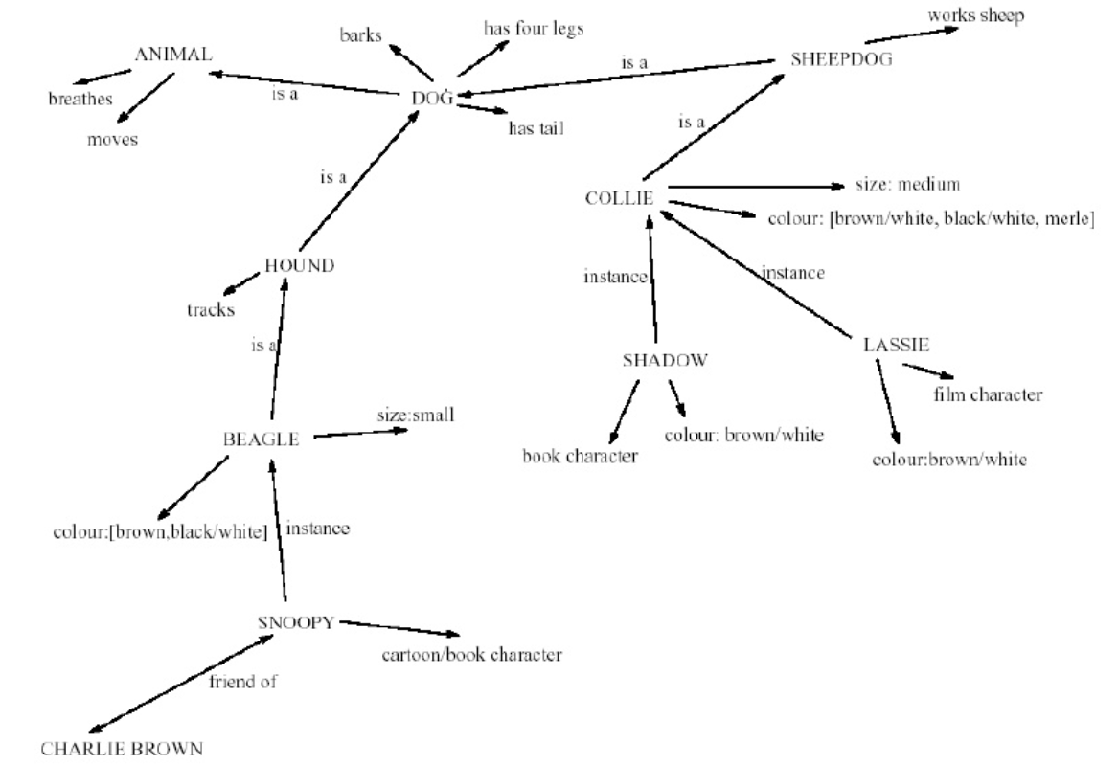
LTM - Semantic network

Slide 30
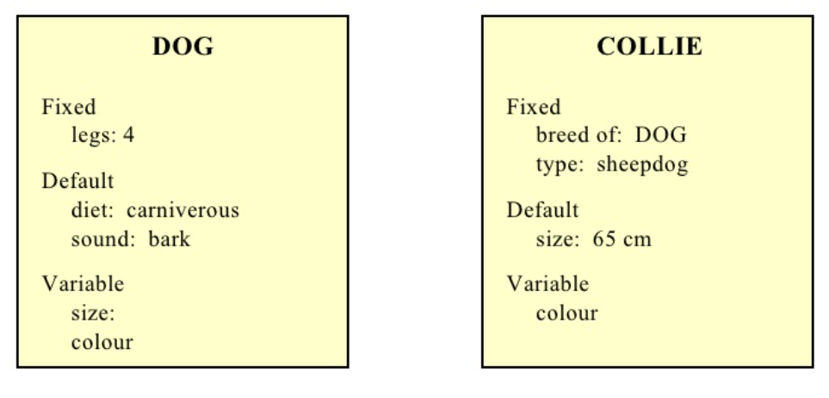
Models of LTM - frames
Information organized and data structure
Slots in structure instantiated with values for instance of data
Type-subtype relationships

Slide 31
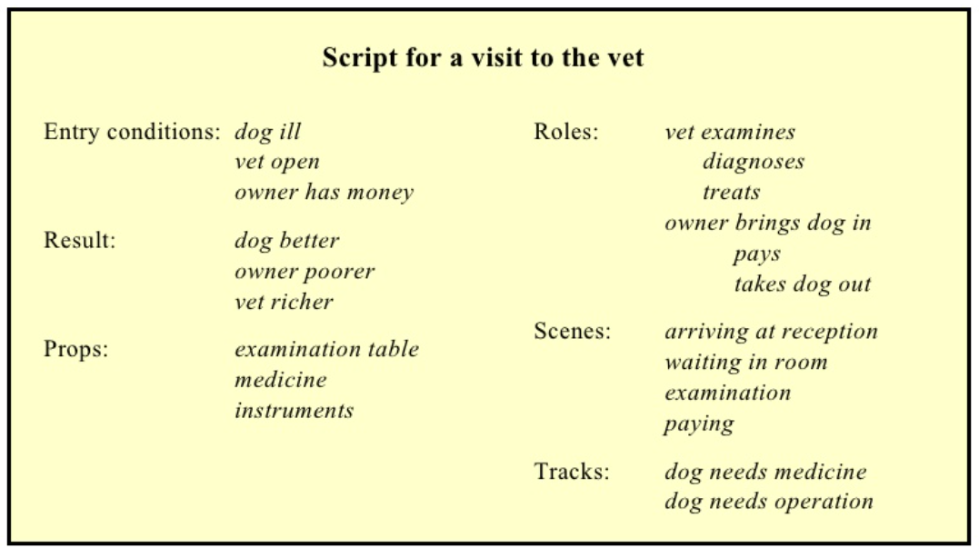
Models of LTM - Scripts
Model of stereotypical information required to interpret situation
Script has elements that can be instantiated with values for context

Slide 32
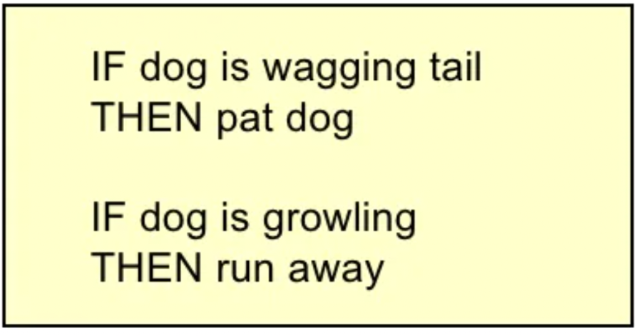
Models of LTM - Production rules
Representation of procedural knowledge
Condition/ action rules
If condition is matched
then use rule to determine action

Slide 33
THE HUMAN
-
MEMORY
LONG-TERM MEMORY
Storage of information
  Rehearsal:
  information moves from STM to LTM
  total time hypothesis:
  amount retained proportional to rehearsal time
  distribution of practice effect:
  optimized by spreading learning over time
  structure, meaning and familiarity:
  information easier to remember

Slide 34
THE HUMAN
-
MEMORY
LONG-TERM MEMORY
Forgetting:
  Decay:
  information is lost gradually but very slowly
  Interference:
  – new information replaces old: retroactive interference
  – old may interfere with new: proactive inhibition
  so may not forget at all memory is selective …
  … affected by emotion
  – can subconsciously `choose' to forget

Slide 35
THE HUMAN
-
MEMORY
LONG-TERM MEMORY
Storage of information
Forgetting:
Retrieval
  Recall
  – information reproduced from memory can be assisted by cues, e.g. categories, imagery
  Recognition
  – information gives knowledge that it has been seen before
  – less complex than recall - information is cue

Slide 36

THE HUMAN
-
THINKING
REASONING
  Deduction
  Induction
  Abduction
PROBLEM SOLVING
ERROR & MENTAL
MODELS

Slide 37
THE HUMAN
- THINKING
Deduction
  derive logically necessary conclusion from given premises
Logical conclusion not necessarily true
When truth and logical validity clash
People bring world knowledge to bear
REASONING
  Deduction
  Induction
  Abduction
PROBLEM SOLVING
ERROR & MENTAL
MODELS
Notes:
Lý luận khấu trừ
rút ra kết luận cần thiết về mặt logic từ các tiền đề đã cho
Kết luận logic không nhất thiết phải đúng
Khi sự thật và giá trị hợp lý xung đột
Con người mang kiến thức thế giới để mang

Slide 38
THE HUMAN
- THINKING
Induction
  generalize from cases seen to cases unseen
Unreliable
  can only prove false not true … BUT USEFUL!
Humans not good at using negative evidence
REASONING
  Deduction
  Induction
  Abduction
PROBLEM SOLVING
ERROR & MENTAL
MODELS
Notes:
Lý luận quy nạp
khái quát hóa từ các trường hợp đã nhìn thấy đến các trường hợp không nhìn thấy
Không đáng tin cậy
chỉ có thể chứng minh sai không đúng sự thật… NHƯNG HỮU ÍCH!
Con người không giỏi sử dụng bằng chứng tiêu cực

Slide 39
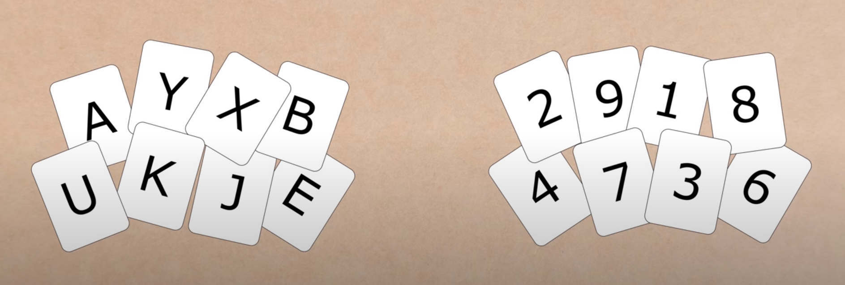
Wason’s cards

Slide 40
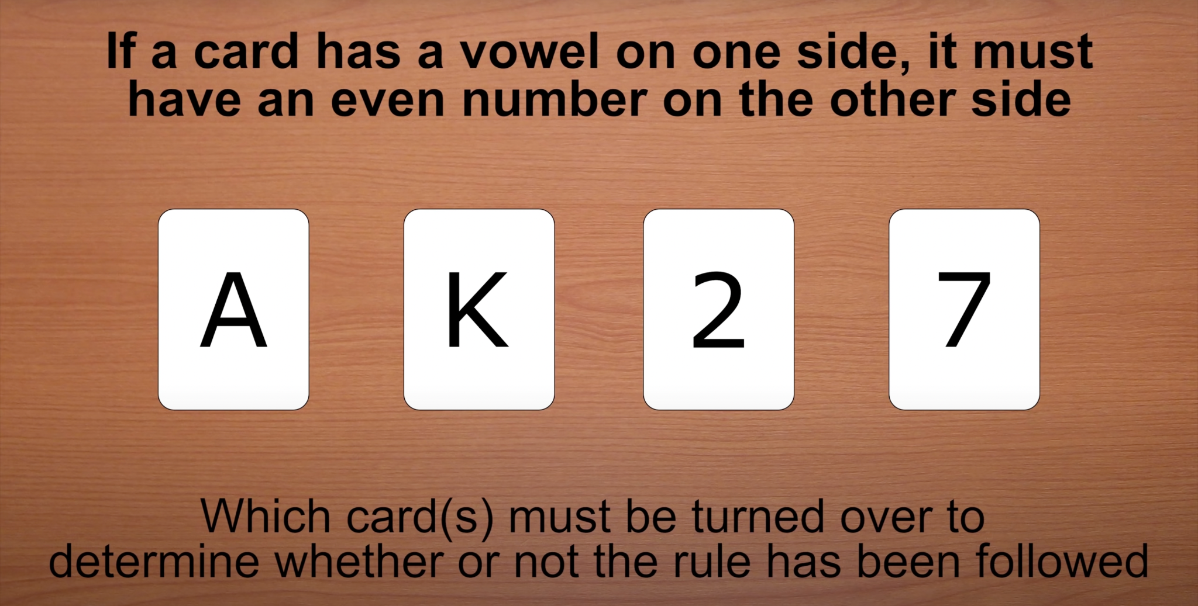
Wason’s cards

Slide 41
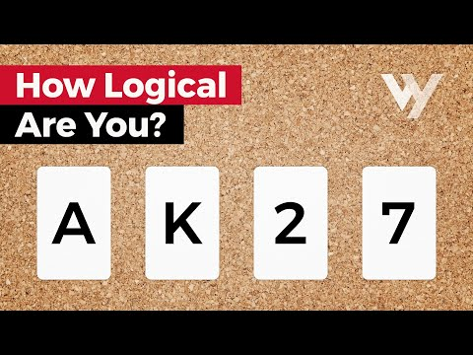

Slide 42
THE HUMAN
- THINKING
Reasoning from event to cause
  Sam drives fast when drunk.
  If I see Sam driving fast, assume drunk.
Unreliable
  can lead to false explanations
REASONING
  Deduction
  Induction
  Abduction
PROBLEM SOLVING
ERROR & MENTAL
MODELS
Notes:
Lý luận bắt cóc
Suy luận từ sự kiện đến nguyên nhân
Sam lái xe nhanh khi say rượu.
Nếu tôi thấy Sam lái xe nhanh, hãy cho là say rượu.
Không đáng tin cậy
có thể dẫn đến giải thích sai

Slide 43
THE HUMAN
- THINKING
Process of finding solution to unfamiliar task using knowledge.
Several theories.
Gestalt
Problem space theory
Analogy
Skill acquisition
REASONING
  Deduction
  Induction
  Abduction
PROBLEM SOLVING
ERROR & MENTAL
MODELS
Notes:
Quá trình tìm kiếm giải pháp cho nhiệm vụ không quen thuộc bằng cách sử dụng kiến thức.
Một số lý thuyết.
Gestalt
Vấn đề lý thuyết không gian
Sự giống nhau
Thu nhận kỹ năng

Slide 44


Slide 45
THE HUMAN
- THINKING
2 TYPES OF ERROR
SLIPS
  Right intention, but failed to do it right
  Cause: poor physical skill, inattention etc…
  Change to aspect of skilled behavior can cause slip
MISTAKES
  Wrong intention
  Cause: incorrect understanding
  Humans create mental models to explain behaviour.
  If wrong (different from actual system) errors can occur
REASONING
  Deduction
  Induction
  Abduction
  Analogical
PROBLEM SOLVING
ERROR & MENTAL
MODELS
Notes:
2 LOẠI LỖI
SLIPS
Ý định đúng, nhưng không thực hiện được
Nguyên nhân: kỹ năng thể chất kém, thiếu chú ý, v.v.
Thay đổi khía cạnh của hành vi có kỹ năng có thể gây trượt
MISTAKES
Ý định sai
Nguyên nhân: hiểu sai
Con người tạo ra các mô hình tinh thần để giải thích hành vi.
Nếu sai (khác với hệ thống thực tế) có thể xảy ra lỗi

Slide 46
THE HUMAN
-
EMOTION
VARIOUS THEORIES OF HOW EMOTION WORKS
  James-Lange:
  “Emotion is our interpretation of a physiological reponse to a stimuli”
  Cannon:
  “Emotion is a psychological response to a stimuli”
  Schacter-Signer:
  “Emotion is the result of our evaluation of our physiological responses, in the light of the whole situation we are in”
EMOTION CLEARLY INVOLVES BOTH COGNITIVE AND PHYSICAL RESPONSES TO STIMULI
Notes:
CÁC LÝ THUYẾT KHÁC NHAU VỀ CÁCH CẢM XÚC HOẠT ĐỘNG
James-Lange:
"Cảm xúc là cách giải thích của chúng ta về một phản ứng sinh lý đối với các kích thích"
Cannon:
"Cảm xúc là một phản ứng tâm lý đối với các kích thích"
Người ký Schacter:
"Cảm xúc là kết quả của việc đánh giá các phản ứng sinh lý của chúng ta, dựa trên toàn bộ tình huống mà chúng ta đang gặp phải"
CẢM XÚC RÕ RÀNG LIÊN QUAN ĐẾN CẢ HAI CÂU LẠC BỘ VÀ VẬT LÝ ĐỐI VỚI KÍCH ỨNG

Slide 47
THE HUMAN
-
EMOTION
THE BIOLOGICAL RESPONSE TO PHYSICAL STIMULI IS CALLED AFFECT
AFFECT INFLUENCES HOW WE RESPOND TO SITUATIONS
  Positive → creative problem solving
  Negative → narrow thinking
“Negative affect can make it harder to do even easy tasks;
Positive affect can make it easier to do difficult tasks”
(Donal Norman)
Notes:
PHẢN ỨNG SINH HỌC ĐỐI VỚI STIMULI VẬT LÝ ĐƯỢC GỌI LÀ ẢNH HƯỞNG
ẢNH HƯỞNG ẢNH HƯỞNG ĐẾN CÁCH CHÚNG TÔI ỨNG PHÓ CÁC TÌNH HUỐNG
Tích cực → giải quyết vấn đề sáng tạo
Tiêu cực → suy nghĩ hạn hẹp
“Ảnh hưởng tiêu cực có thể khiến bạn khó thực hiện những nhiệm vụ thậm chí dễ dàng hơn;
Tác động tích cực có thể giúp bạn thực hiện những nhiệm vụ khó khăn dễ dàng hơn ”
(Donal Norman)

Slide 48
THE HUMAN
-
EMOTION
IMPLICATIONS FOR INTERFACE DESIGN
  Stress will increase the difficulty of problem solving
  Relaxed users will be more forgiving of shortcomings in design
  Aesthetically pleasing and rewarding interfaces will increase positive affect
Notes:
GỢI Ý THIẾT KẾ GIAO DIỆN
Căng thẳng sẽ làm tăng khó khăn khi giải quyết vấn đề
Người dùng thoải mái sẽ dễ dàng tha thứ hơn cho những thiếu sót trong thiết kế
Các giao diện đẹp và bổ ích về mặt thẩm mỹ sẽ tăng ảnh hưởng tích cực

Slide 49
THE HUMAN
-
INDIVIDUAL DIFFERENCES
LONG-TERM
  Gender, physical and intellectual abilities
SHORT-TERM
  Effect of stress or fatigue
CHANGING
  Age
Ask yourself:
Will design decision exclude section of user population?

Slide 50
THE HUMAN
-
PSYCHOLOGY
and the design of interractive system
Some direct applications
However, correct application generally requires understanding of context in psychology, and an understanding of particular experimental conditions
A lot of knowledge has been distilled in
  Guidelines
  Cognitive models
  Experimental and analytic evaluation techniques
Notes:
Một số ứng dụng trực tiếp
Tuy nhiên, việc áp dụng đúng cách thường đòi hỏi sự hiểu biết về ngữ cảnh trong tâm lý học và sự hiểu biết về các điều kiện thực nghiệm cụ thể.
Rất nhiều kiến thức đã được chắt lọc trong
Nguyên tắc
Mô hình nhận thức
Kỹ thuật đánh giá thực nghiệm và phân tích

Slide 51

Thanks!
Do you have any questions?
chrizmonkey@gmail.com
+84 0937 566 561

